Slide 1
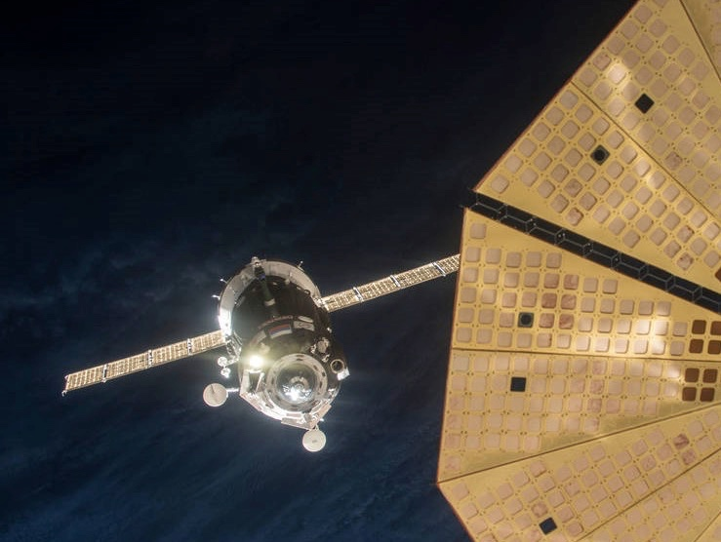
Knowledge Architecture
Combining Strategy, Data Science and Informatics to Transform Data in to Actionable Knowledge
R Ladies Austin
July 1, 2017
David Meza
Chief Knowledge Architect
NASA Johnson Space Center
Notes:
IMAGE: Expedition 46 Soyuz Approaches Space Station for Docking
Russian cosmonaut Yuri Malenchenko manually docked the Soyuz TMA-19M spacecraft on Dec. 15, 2015 to the International Space Station's Rassvet module after an initial automated attempt was aborted. Flight Engineer Tim Kopra of NASA and Flight Engineer Tim Peake of ESA flanked Malenchenko as he brought the Soyuz to the Rassvet port.

Slide 2

Challenges
46%
30%
54%
of total R&D spend is wasted duplicating research and work previously done.
Source: National Board of Patents and Registration (PRH), WIPO, IFA
of decisions are made with incomplete, inconsistent and inadequate information
Source: InfoCentric Research
Workers can’t find the information they need almost half the time.
Source: IDC
Notes:
Here, Imagine this is all the information at your finger tips. How powerful are you if 46% of workers cannot find the information they need. Can you find the Earth?
Or maybe we turn left at Alpha Centauri instead of right because we have incomplete information and end up Lost In Space.
To help with our problem, let us apply some Knowledge Architecture
First from Knowledge Management we apply a taxonomy and ontology to our information.
Second through Data Science, we run analysis, maybe clustering and classification using our ontology
Third, Information Architecture: Data management, meta data, well designed interactive UI
Lead to Repository specific search
In 2012 Gartner reported there will be an 800% increase in data by 2018 and 90% will be unstructured.

Slide 3

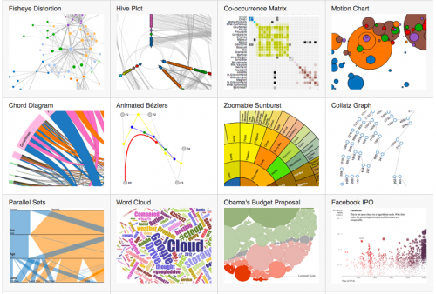


To convert data to knowledge a convergence of Knowledge Management, Knowledge Informatics and Data Science is necessary.
Knowledge Management
Knowledge Informatics
Data Science
Notes:
The role of the Chief Data Officer – CIO is responsible for the pipes the data runs through, CDO is responsible for the data running through the pipes.
Combination of Knowledge Management, Data Science and Information Architecture
Information Architecture– Understanding your data, users and creation processes
Analytics – Using data science techniques to extract knowledge from implicit data
Knowledge Management– Utilizes the inputs from DM and Analytics to provide the tools and process to display the end results in a manner conducive to the user

Slide 4
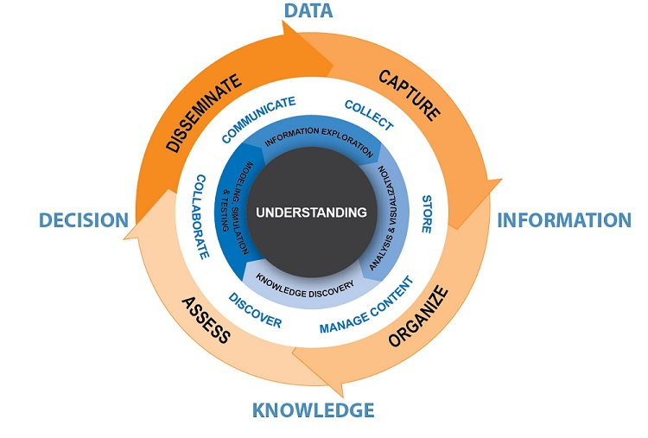
JSC Knowledge Management Strategy
Objectives
Business Development
Business Case
Budgets
Communication
JSC Guidelines
Strategy
People
Knowledge Architecture
Change Mgmt.
JSC Culture
Resources
People/Tools
Governance
MDM, Taxonomy
Process
Knowledge Process
KM Approaches
Measurement
Content and IT
Content Mgmt.
IT Process &Tools
Notes:
The role of the Chief Data Officer – CIO is responsible for the pipes the data runs through, CDO is responsible for the data running through the pipes.
Combination of Knowledge Management, Data Science and Information Architecture
Information Architecture– Understanding your data, users and creation processes
Analytics – Using data science techniques to extract knowledge from implicit data
Knowledge Management– Utilizes the inputs from DM and Analytics to provide the tools and process to display the end results in a manner conducive to the user

Slide 5
Knowledge Architecture
Knowledge Management Knowledge Informatics Data Science
Data Acquisition & Creation
Data Management
Data Warehousing
Data Analytics, BI (Knowledge Extraction)
Knowledge Presentation and Visualization
Source
User
Sources:
Sensor
Experimental
Computed (modeling & simulation)
Forms:
Digital
Text
Visual
Organization:
Structured
Semi-Structured
Unstructured
Functions:
Governance
Taxonomy
Ontology
Comm Plan
Operations Management
Security
Master Data Management
Content Management
Metadata
Data Quality
Tools & Environments:
Large scale storage
RDBMS
Parallel RDBMS
NOSQL
Hadoop
Organization:
Structured
Semi-Structured
Unstructured
Tools & Environments:
Computation & data access
Data Mining
Text Mining
Optimization
Neural Net
ML Algorithms
Visualization
Access Pattern:
Structured
Semi-Structured
Unstructured
Predictable
Unpredictable
Data Products:
Predictions
Models
Visualizations
Decision Analysis
Wiki
Security, Data Quality, Workflow Management, Data Management, Resource Management
IT Infrastructure
Notes:
The role of the Chief Data Officer – CIO is responsible for the pipes the data runs through, CDO is responsible for the data running through the pipes.
Combination of Knowledge Management, Data Science and Information Architecture
Information Architecture– Understanding your data, users and creation processes
Analytics – Using data science techniques to extract knowledge from implicit data
Knowledge Management– Utilizes the inputs from DM and Analytics to provide the tools and process to display the end results in a manner conducive to the user

Slide 6
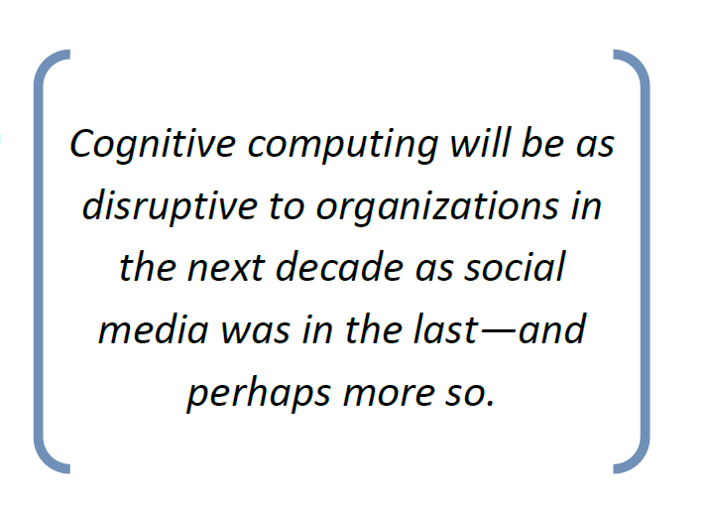
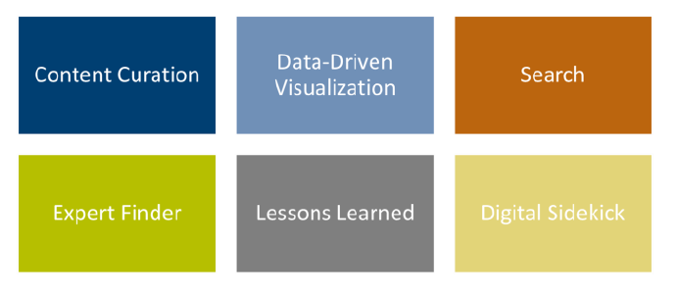
Knowledge Architecture: The Next Phase

Slide 7

Knowledge Architecture critical success factors
There is No One Solution
Master Data Management Plan is essential
Identify Critical Data
Develop Standards for Government and Contractor created data
Analytics is essential
Meta Data
Notes:
Our primary system of finding and presenting data is not working, we are trying to force all types of data into one presentation method
Exhibit – Exploratory - Explanatory

Slide 8

Developing Your Toolset

Slide 9
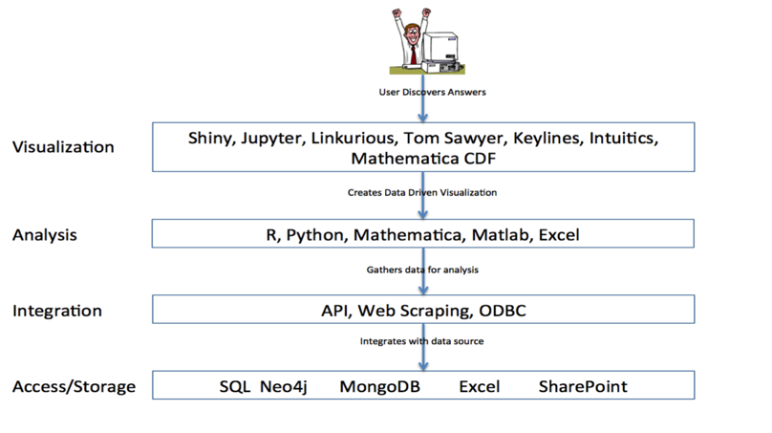
Notes:
Currently, I see three major opportunities where Knowledge Architecture
Search
Here I am not talking about Google, or Bing, I refer to the use of different search methodologies to help make it easier for workers to extract knowledge. Making sure your strategy for creating and storing information enables the search methodologies to increase your return relevancy.
Taxonomy/Ontology aid in classification
Metadata
Clustering, Topic Modeling,
Data Driven Visualization
The emergence of data science techniques and models has given Knowledge Architects the capabilities to transform information into working knowledge that can be created and accessed on the fly. Machine learning models can be applied to newly created information returning more accurate knowledge allowing users to make for informed decisions.
Storage
The development of various new NOSQL storage applications will allow us to query faster, see patterns easier and connect seemingly disparate information.
Separately all of these areas are beneficial to the enterprise, together they provide a completive edge. You need a group they can speak all three languages and liaison between them.
Explain picture

Slide 10

There was a inquisitive engineer…

Slide 11

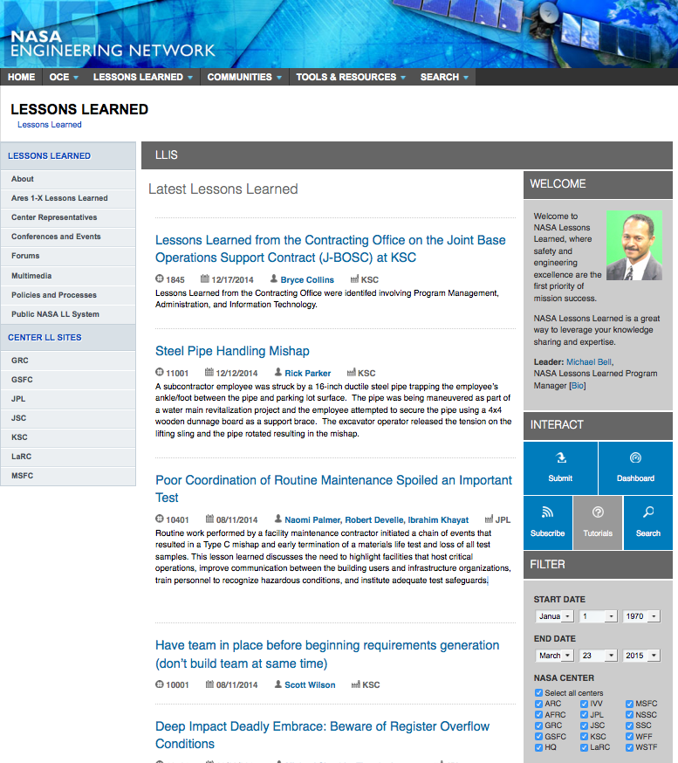
Lesson learned database
2031 lessons submitted across NASA. Filter by date and Center only.
Useful information stored in database.
Notes:
The database was not being used on a regular basis to extract lesson and when it was users complained on how difficult it was to find appropriate lessons. They had to read through too many lessons, wasting precious project time. Users could only filter by date or Center, even though the lesson contained other useful information, such as, category, safety related, program or project phase, directorate etc.
Fortunately the data set contained substantial metadata, providing opportunities to enhance the exploration of the corpus through the generated topics models. Late we will demonstrate how to find documents quickly and their association to the metadata.

Slide 12
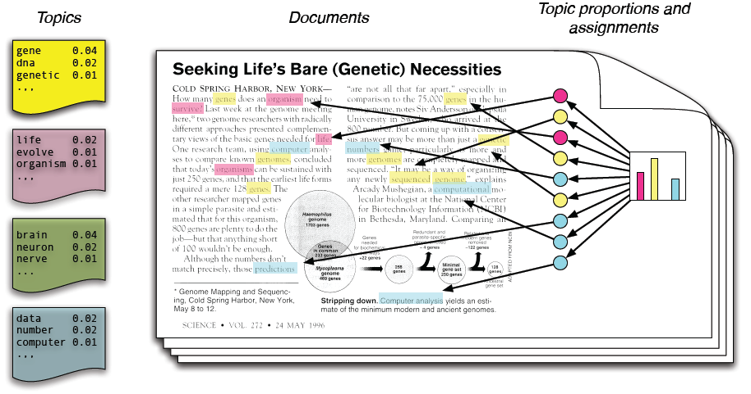
Topic modeling
LDA Model from Blei (2011)
Topic models are based upon the idea that documents are mixtures of topics, where a topic is a probability distribution over words.
Blei, David M. 2011. “Introduction to Probabilistic Topic Models.” Communications of the ACM.
David Blei homepage - http://www.cs.columbia.edu/~blei/topicmodeling.html
Notes:
Topic modeling provides an algorithmic solution to managing, organizing and annotating large archival text. The annotations aid you in tasks of information retrieval, classification and corpus exploration
Topic models provide a simple way to analyze large volumes of unlabeled text. A "topic" consists of a cluster of words that frequently occur together. Using contextual clues, topic models can connect words with similar meanings and distinguish between uses of words with multiple meanings. For a general introduction to topic modeling, see for example Probabilistic Topic Models by Steyvers and Griffiths (2007).
In machine learning and natural language processing topic models are generative models which provide a probabilistic framework for the term frequency occurrences in documents in a given corpus.

Slide 13
Correlation by Category
To find the per-document probabilities we extract theta from the fitted model’s topic posteriors

Slide 14
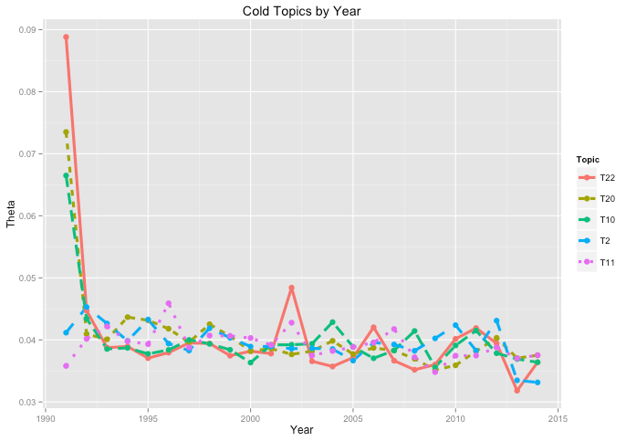
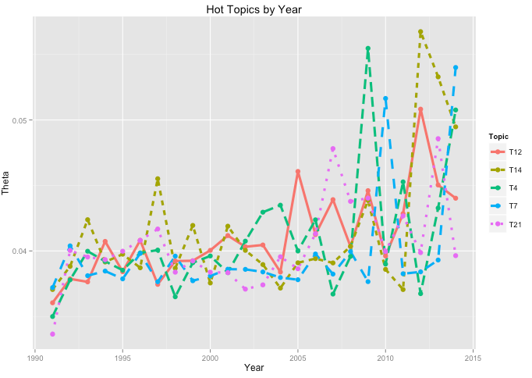
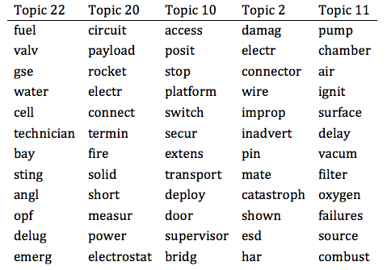
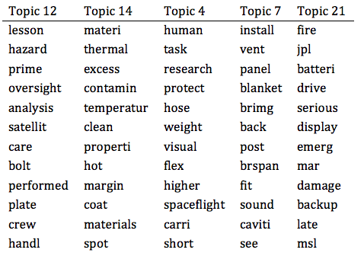
Topic Trends
Using mean of theta by years to trend topics

Slide 15
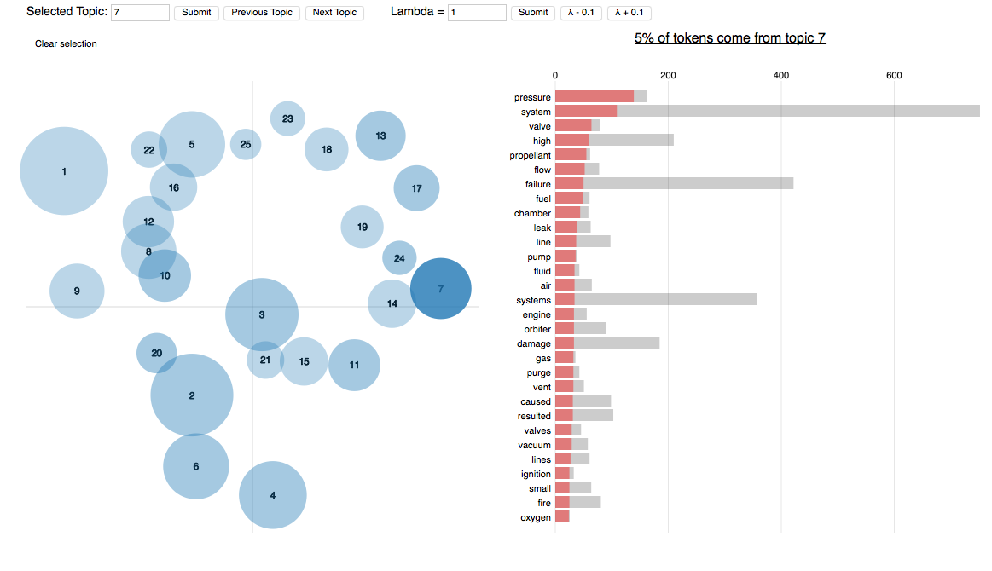
Topic visualization

Slide 16
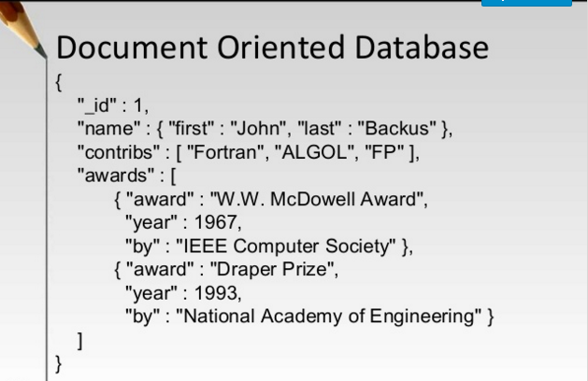
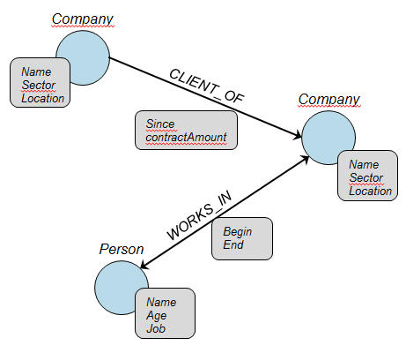
Document to Graph

Slide 17

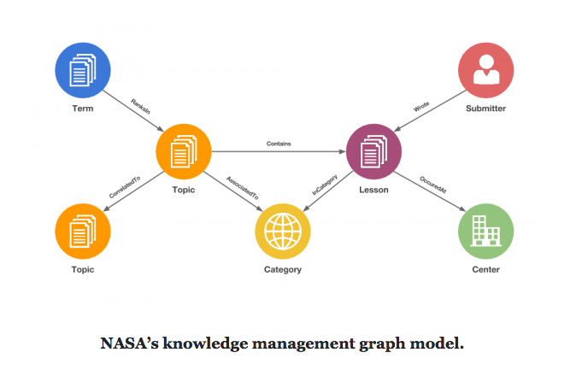
Graph Model of Lesson Learned Database
Notes:
I drew a rough outline showing the various connections of the proposed nodes in the graph. It is fairly simple, however I found it helps keep me focused on the model.
http://davidmeza1.github.io/2015/07/16/Graphing-a-lesson-learned-database.html

Slide 18
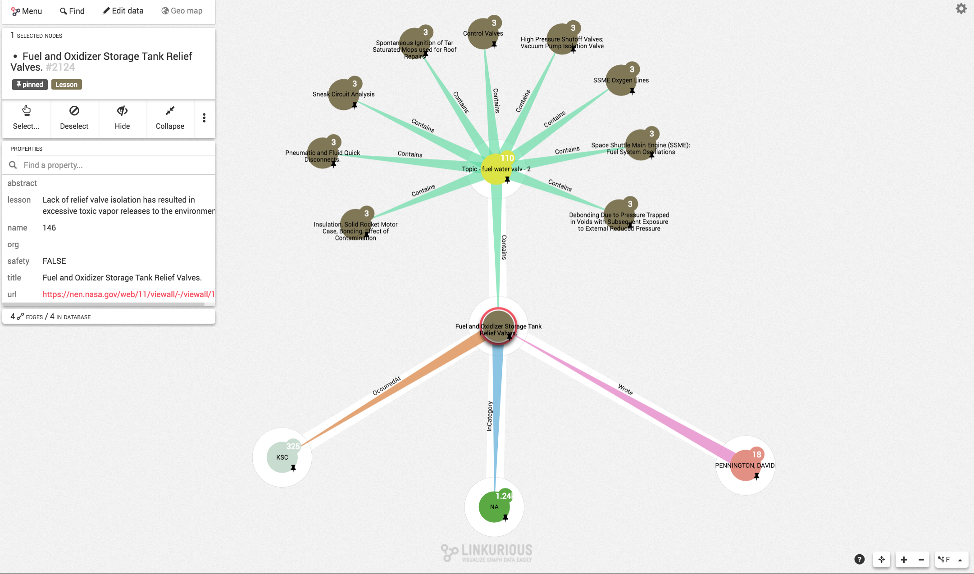

Slide 19
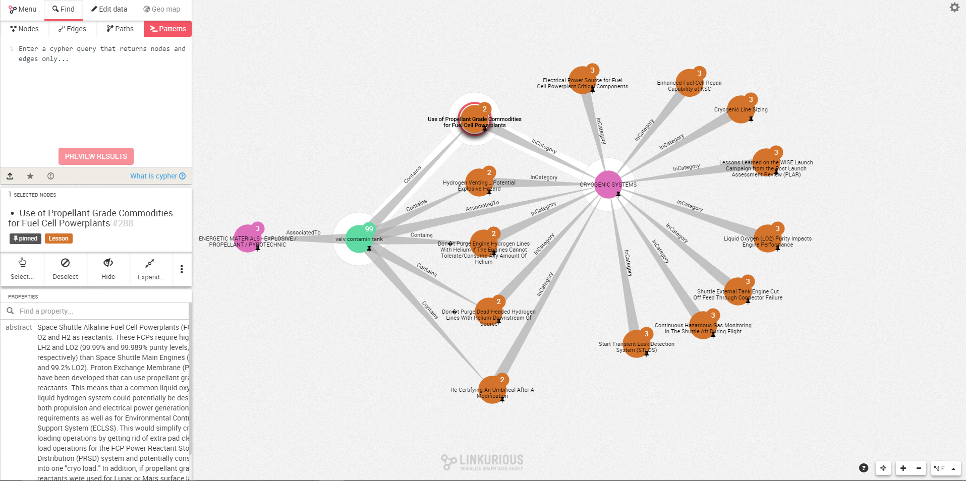

Slide 20
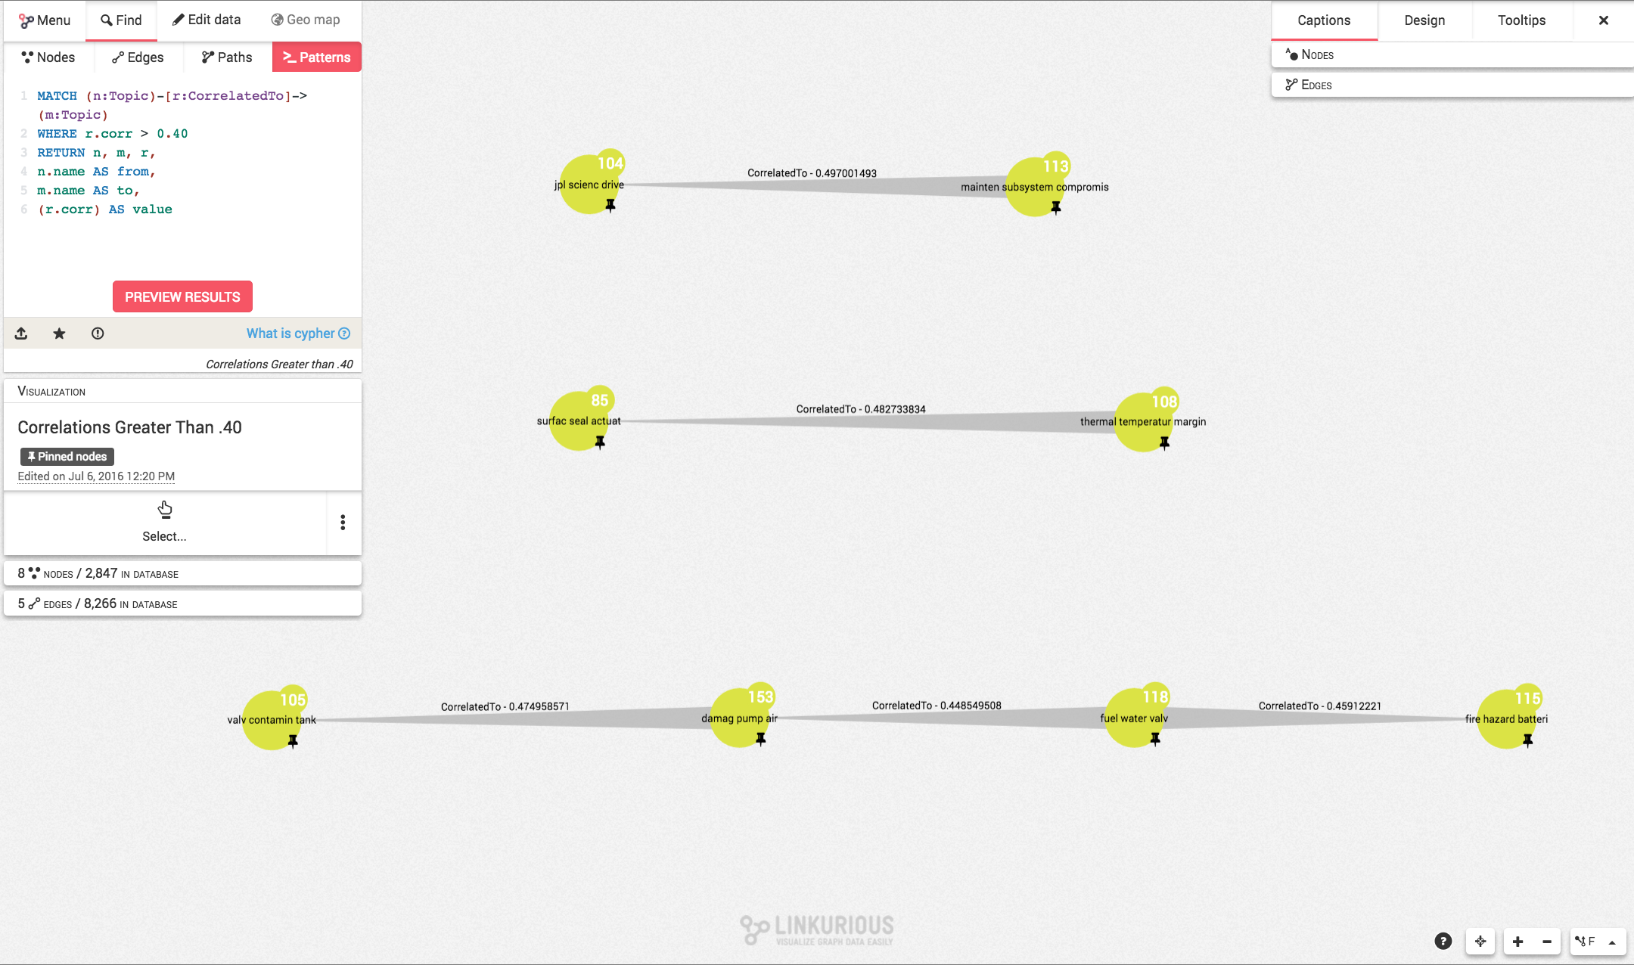

Slide 21
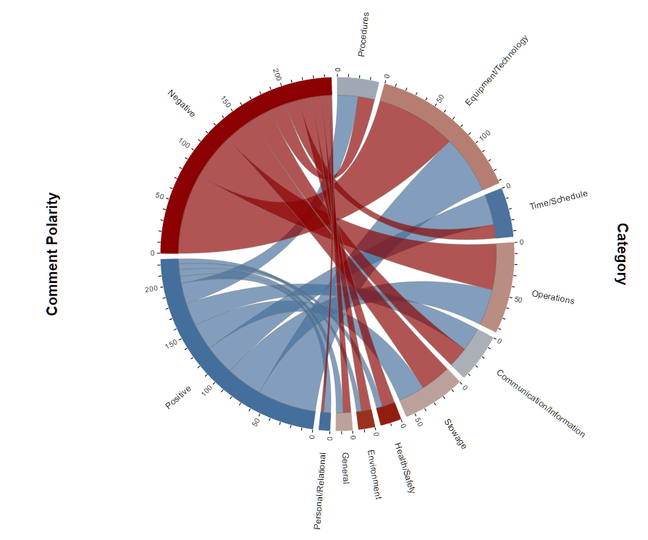
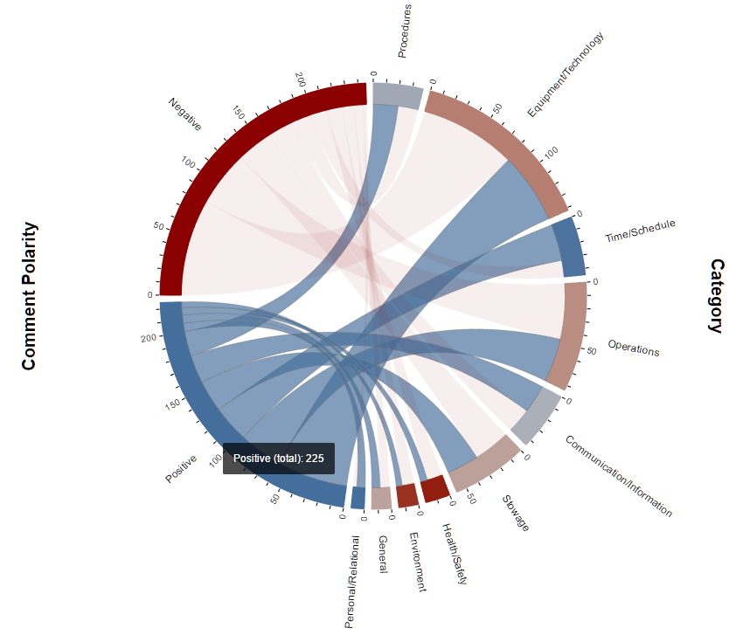
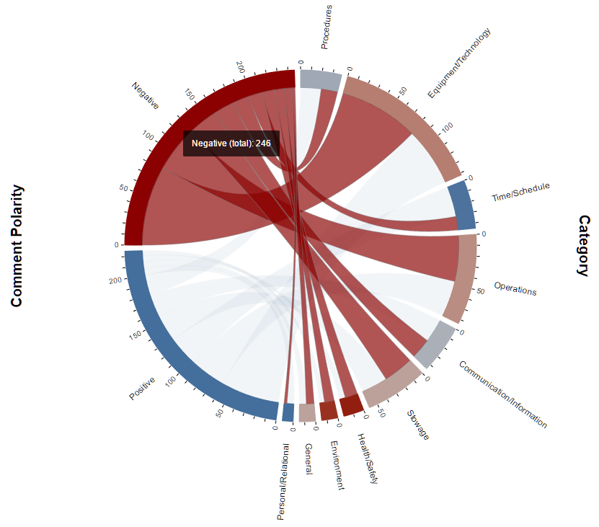
Analytics Aided Human Factors
Notes:
The role of the Chief Data Officer – CIO is responsible for the pipes the data runs through, CDO is responsible for the data running through the pipes.
Combination of Knowledge Management, Data Science and Information Architecture
Information Architecture– Understanding your data, users and creation processes
Analytics – Using data science techniques to extract knowledge from implicit data
Knowledge Management– Utilizes the inputs from DM and Analytics to provide the tools and process to display the end results in a manner conducive to the user

Slide 22
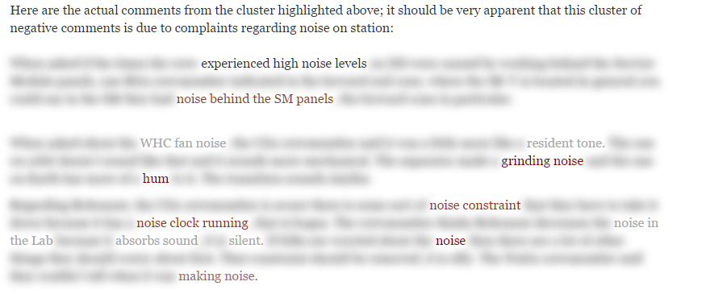
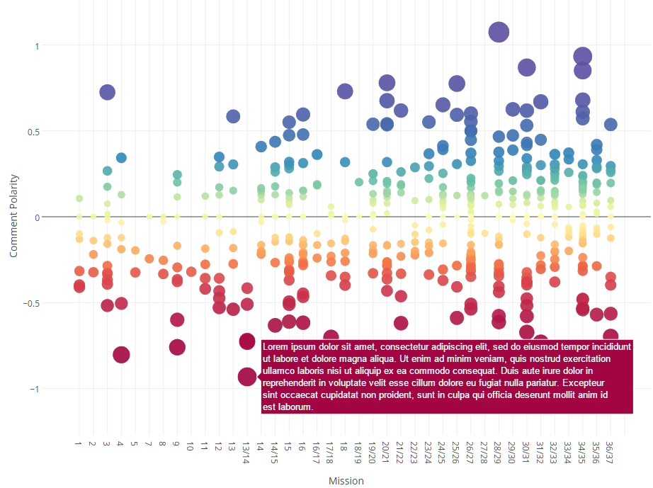
Identifying Polarity Across Crew Comments

Slide 23
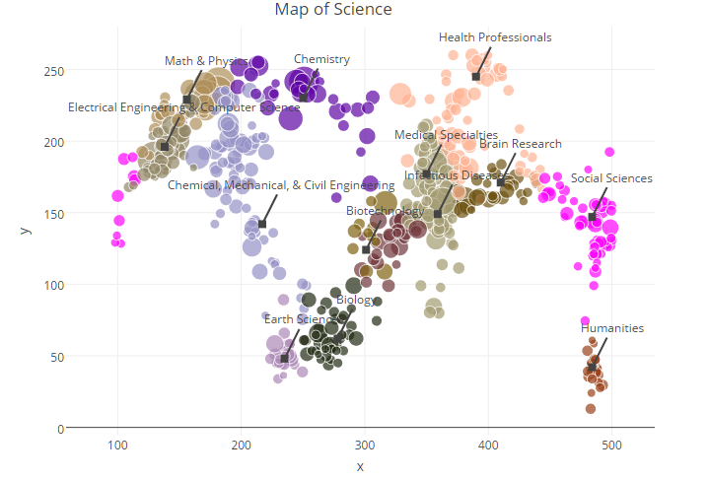
Web of Science

Slide 24
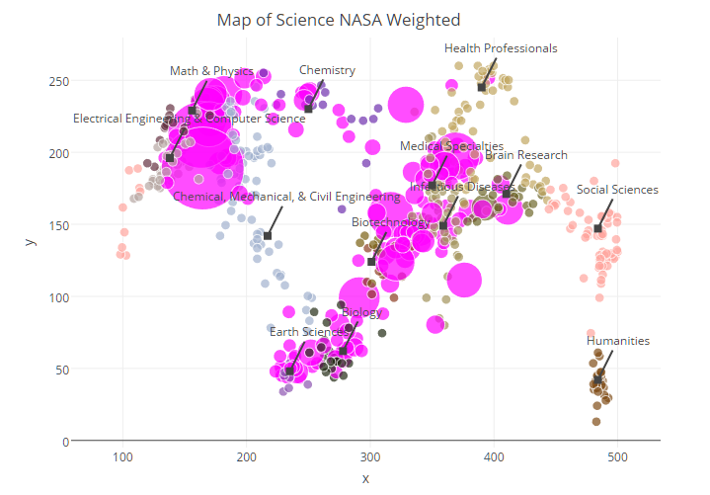
Overlay of ISS Investigations

Slide 25
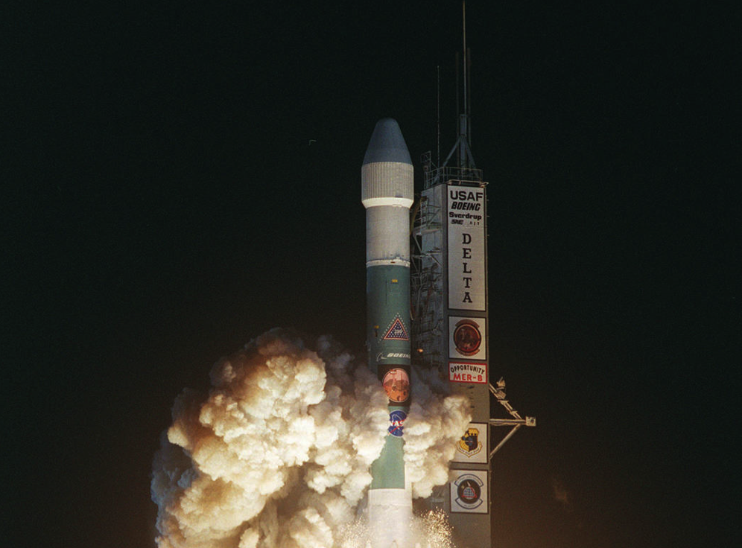
Contact Information David Meza – david.meza-1@nasa.gov Twitter - @davidmeza1 Linkedin - https://www.linkedin.com/pub/david-meza/16/543/50b Github – davidmeza1 Blog davidmeza1.github.io

Slide 26

QUESTIONS?
Notes:
NASA Astronaut Tim Kopra on Dec. 21 Spacewalk
Expedition 46 Flight Engineer Tim Kopra on a Dec. 21, 2015 spacewalk, in which Kopra and Expedition 46 Commander Scott Kelly successfully moved the International Space Station's mobile transporter rail car ahead of Wednesday's docking of a Russian cargo supply spacecraft.

